Slide 1
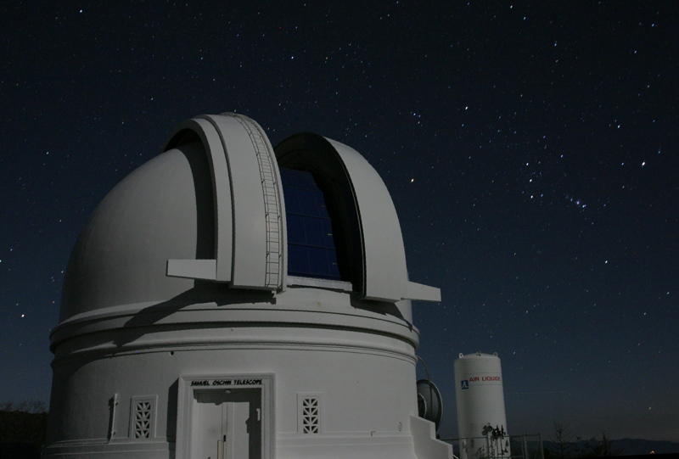

Real-Bogus Classifiers for the intermediate Palomar Transient Factory
Umaa Rebbapragada
Jet Propulsion Laboratory,
California Institute of Technology Umaa.D.Rebbapragada@jpl.nasa.gov
With Brian Bue (JPL/Caltech), Gary Doran (JPL/Caltech), Przemek Wozniak (LANL), Russ Laher (IPAC/Caltech), Frank Masci (IPAC/Caltech), Adam Miller (JPL/Caltech), Mansi Kasliwal (Caltech)
Courtesy: PTF
Research described in this presentation was carried out at the Jet Propulsion Laboratory under a Research and Technology Development Grant, under contract with the National Aeronautics and Space Administration. Copyright 2013 California Institute of Technology. All Rights Reserved. US Government Support Acknowledged.

Slide 2
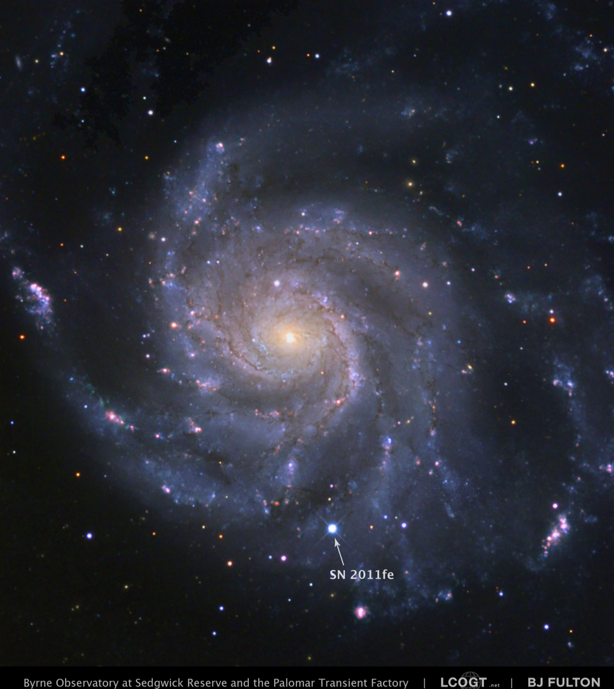
Optical Transient Vetting
Transients: supernovae (short duration), variable stars (persistent)
The intermediate Palomar Transient Factory (iPTF) is a fully-automated, wide-field survey run by Caltech
Near real-time exploration of optical transient sky
Timely follow up on partner assets (e.g. Keck telescope) for spectroscopy
500K-10M objects (sources) per night
Reference: B. J. Fulton/LCOGT/PTF
Notes:
What is the science problem
- How does this fit into larger JPL push

Slide 3
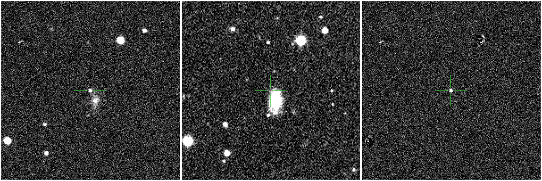
Image Subtraction
Is this real or bogus?
Science
Reference
Subtracted
Notes:
iPTF uses image differencing excels in regions where source confusion is high and where complex fast-varying backgrounds are present (e.g., near or within galaxies). However, it presents challenges in terms of the alignment and matching of the PSF profiles of the input science and reference images. This has lead to an intensive and ongoing research on how to do image differencing robustly to eliminate systematic instrument residuals induced by non-optimal calibrations and/or PSF-matching. These leads to an inordinate number of false positives, which PTF relies on machine learned classifier to determine whether the candidate is real or bogus

Slide 4
Real-Bogus Data Flow
Palomar Observatory
IPAC
Streak
Detection
Streaks
Real-Bogus (12)
48” Telescope
Real-time Image Subtraction (PTFIDE)
Point-source Real-Bogus (79)
60” and 200” Telescopes
Lawrence Berkeley Lab / NERSC
Real-time Image Subtraction
Point-source
Real-Bogus (41)
iPTF Consortium
Follow-up Telescopes
Human Vetting by iPTF Consortium
Caltech
Transients Marshall
Asteroids
Marshall
Notes:
CHANGE THIS TO REFLECT NEW REAL-BOGUS at PTFIDE

Slide 5
Volume of Nightly Candidates

Slide 6
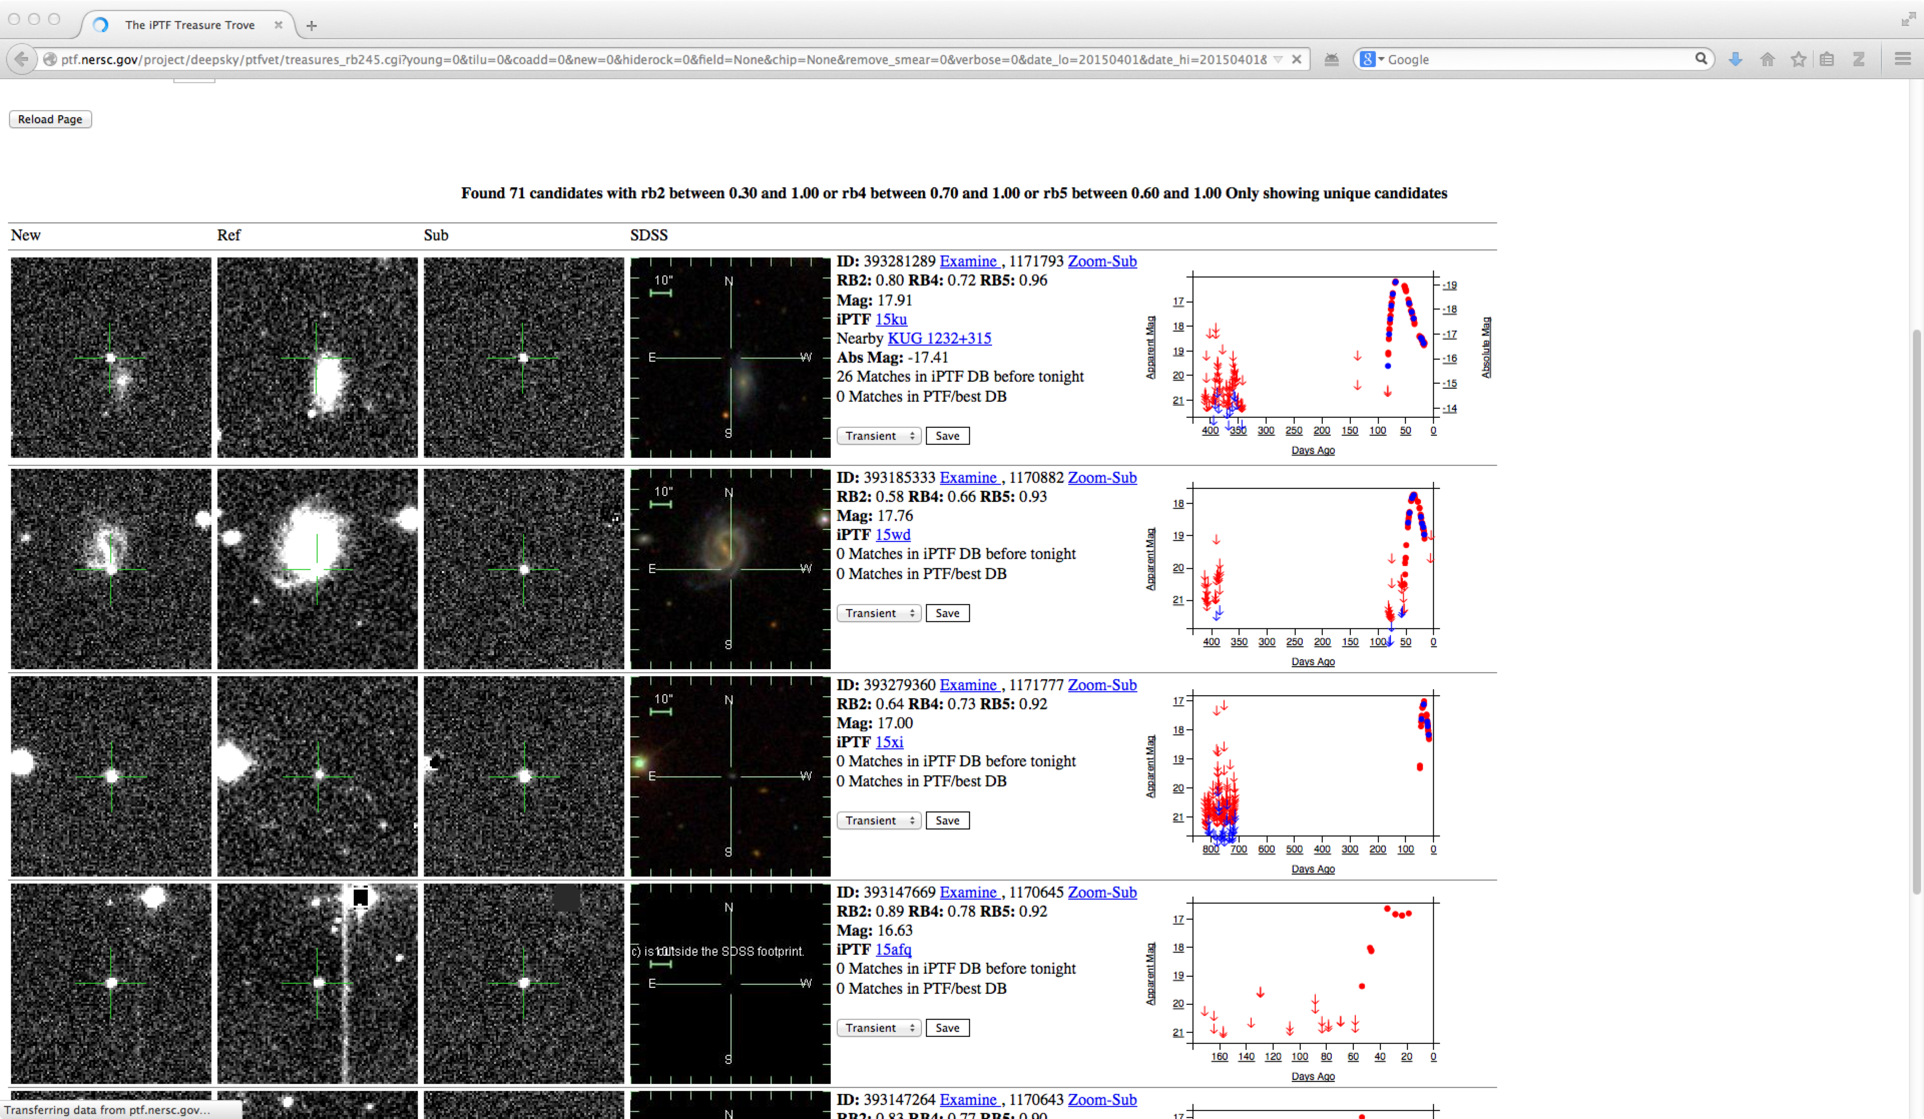
Scanning Page
iPTF limits top 200 candidates for human review
UC Berkeley
JPL
LANL

Slide 7
Challenges
Tolerate at most 1% false positive rate (FPR)
Overfitting
Heterogeneity of bogus
Training set contamination and bias
Shift in data characteristics
software upgrades, survey changes

Slide 8
Training Set Analysis / Cleanup
Clustering to perform a frequency analysis of artifacts
informs image subtraction algorithms
Used active learning to find mislabeled examples
either remove or relabel them
Remove sample bias
random sampling oversamples from bad subtractions
sample across range of magnitudes, subtraction qualities

Slide 9
Removing Sample Bias

Slide 10
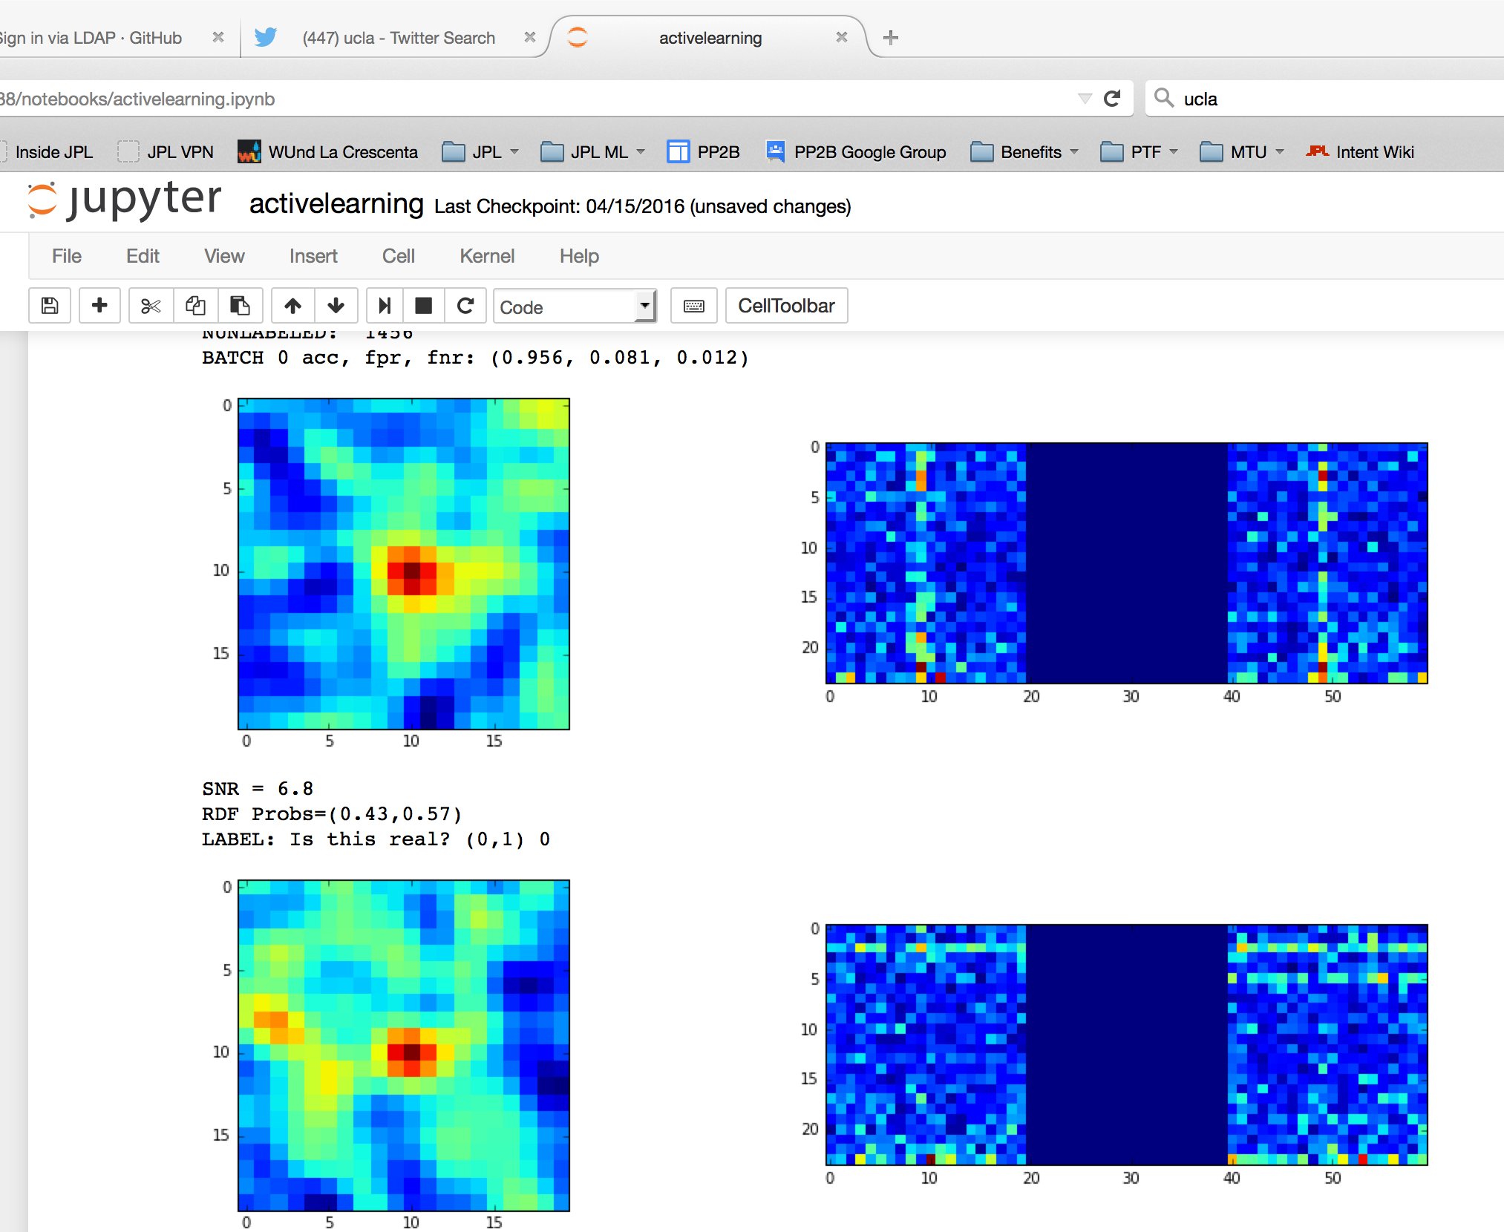
Active Learning at VLA
Recent work from 3-day workshop with Casey Law
Developed prototype to generate training data for VLA
Quick turnaround due to reuse of software infrastructure developed for PTF

